Slide 1
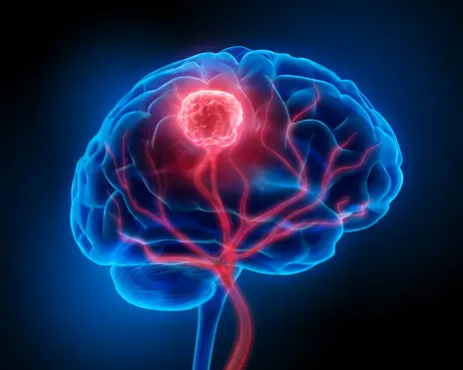
Unveiling the Future of Healthcare
AI-Driven Brain Tumor Detection in MRI Scans
Presented by: Dinesh Chenaramchowdary
Tanvik Poojary

Slide 2
TABLE OF CONTENTS
01
06
Problem Statement
Model Building and Evaluation
02
07
Significance of Brain Tumor
Results and Future Directions
03
08
Process of Model Building
Q & A
04
Exploratory Data Analysis
05
Data Preprocessing

Slide 3
Problem Statement
Challenges
Early Diagnosis
Problem Statement
Goals and Objective
Develop a Deep CNN model capable of predicting the genetic characteristics of brain tumors through MRI scan analysis.
The presence of malignant brain tumors, specifically glioblastoma, is a life-threatening condition characterized by a poor prognosis.
Dynamic Customer Behaviour
Train the model on a diverse dataset of brain MRI scans with labels.
Invasive Procedures
Precision Treatment
There is a critical need for a non-invasive method to predict the brain tumors through imaging (radiogenomics) alone

Slide 4
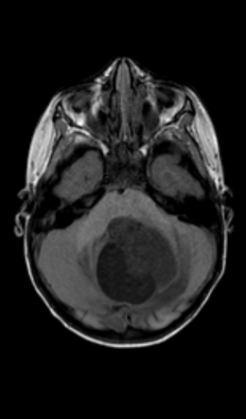
Significance of Brain Tumor
Brain tumors, especially malignant ones like glioblastoma, are associated with a high mortality rate. Glioblastoma, in particular, has a median survival of less than a year, making it one of the most aggressive forms of cancer
Brain tumors can significantly impact a patient's quality of life. They often cause neurological symptoms, including seizures, cognitive impairment, and physical disability.
Diagnosing brain tumors is complicated due to the brain's complex anatomy and the potential overlap of symptoms with other conditions. Early and accurate diagnosis is critical for effective treatment.
Addressing the challenges associated with brain tumors requires innovation in the field of medical imaging and artificial intelligence.
This Photo by Unknown Author is licensed under CC BY-SA-NC

Slide 5

Dataset Source and Overview
The dataset used for this project is retrieved from the Kaggle link https://www.kaggle.com/navoneel/brain-mri-images-for-brain-tumor-detection
Comprehensive dataset with various images where the 129 images are labelled as “yes” that there is a tumor and remaining 98 are labelled “no” which indicates that there is no tumor
Uncovering the tumor and segmentation patterns in MRI images

Slide 6
Process of Model Building
Data Selection and Tools
Selecting data relevant to use case (MRI images).
Data Engineering
Steps Involving Image data preprocessing, and transformation
Exploratory Data Analysis
Transformation
Understanding the dataset with positive and negative labels and transforming images to tensor
Model Creation
Architecture and Training models on data
Model Evaluation
Evaluating the performance of Model from various evaluation metrics

Slide 7
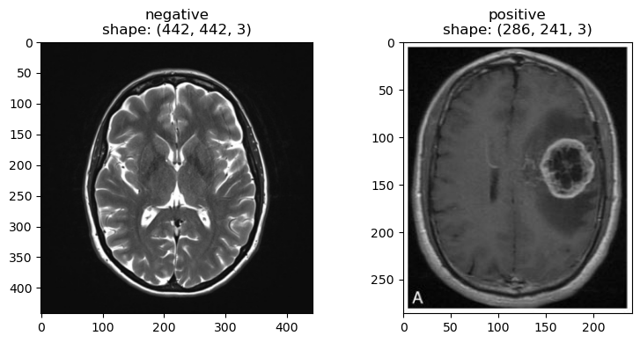
MRI Image Data Sample
MRI without a tumor
MRI with a tumor

Slide 8

Tools and Techniques

Slide 9
Data Cleaning & Preprocessing
Positive = 129 images
Negative = 98 images
Data Cleaning not Required
Cleaning
Labelling | Mapping
Added img_path and target value into data frame
Labelled positive = 1 & negative = 0
Brain Tumor Prediction
Preprocessing
Tensor Image Transformations
Resize (128,128)
Trivial Augument Wide
Converting the data into tensors
Stacking the images of Test and Train
Transformation
Creating custom data sets
Into test and train sets
Batches of 7
Shuffled the images(negative and positive)

Slide 10
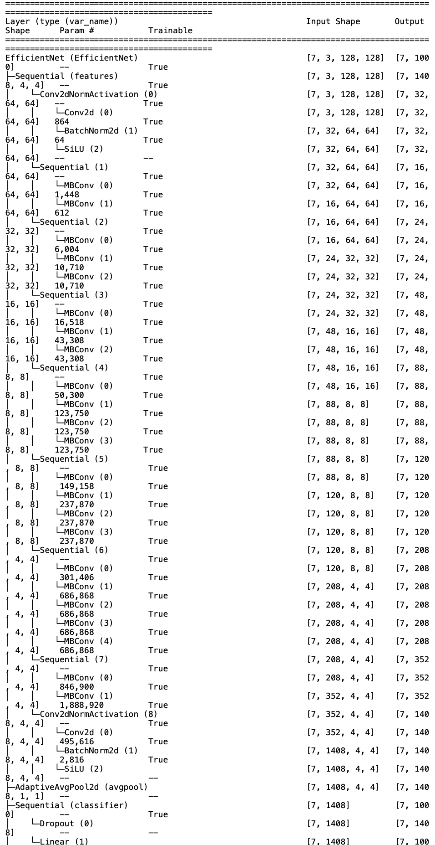
Model Training & Building
Summary
Used EfficientNet model to classify the images
Input size: [7,3,128,128]
Output size: 1000
Number of parameters: 6291136
Trainable: True
The model has 9,109,994 parameters and 1.52 billion multiply-adds (MACs)
Input layer: Takes an input image of 7 pixels tall, 3 pixels wide, and has 128 channels.
Convolutional block: Consists of a series of convolutional layers, each followed by a batch normalization layer and a SiLU(Sigmoid Linear Units) activation function.
Depthwise separable convolution block: Consists of a depthwise separable convolution layer followed by a pointwise convolution layer (filters to the channel input).
Output layer: Produces a 100-dimensional vector of class probabilities.
Training:
Created train and test functions:
Initialized the variables and Iterated through the data using a DataLoader.
Computed forward and backward propagation to update the gradients of the model.
Used BinaryAccuracy class to track the training accuracy (comparing the predicted probabilities to the ground truth labels).
Threshold of 0.5 is set to convert the predicted probabilities to binary predictions where predicted probability is greater than or equal to 0.5, the model predicts the positive class otherwise negative class.
Returns the training loss and accuracy.
Notes:
EfficientNets are based on the idea of compound scaling, which means that they scale all dimensions of a CNN (width, depth, and resolution) uniformly. This results in a family of models that can be scaled to achieve different levels of accuracy and efficiency.
Resnet50 is a 50-layer CNN architecture that was developed by Kaiming He, Xiangyu Zhang, Shaoqing Ren, and Jian Sun in 2015. Resnet50 is based on the idea of residual learning, which means that it learns to add new features to the input image, rather than learning to replace the entire input image. Resnet50 has been shown to achieve state-of-the-art accuracy on a variety of image classification tasks, including ImageNet and CIFAR-10.
EfficientNet is a family of CNN architectures that were developed by Mingxing Tan and Quoc V. Le in 2019. EfficientNets are designed to be both efficient and accurate. They are based on the idea of compound scaling, which means that they scale all dimensions of a CNN (width, depth, and resolution) uniformly. This results in a family of models that can be scaled to achieve different levels of accuracy and efficiency. EfficientNets have been shown to achieve state-of-the-art accuracy on a variety of image classification tasks, including ImageNet and CIFAR-10.

Slide 11
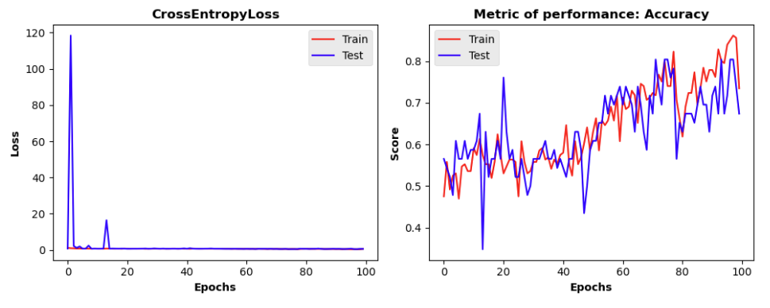
Model Loss Evaluation
Cross Entropy Loss:
In the initial epoch the loss is typically high as the model makes random predictions
It gradually converges to a minimum point where the model’s predictions align more closely with true labels
As we can see in the below plot that after 20 epochs the loss is at minimum point and converged
Accuracy: Train vs Test
From the below plot, we can analyze the model’s performance with the train and test
We can see that over the epochs the model is trained with train data and test data accuracy

Slide 12
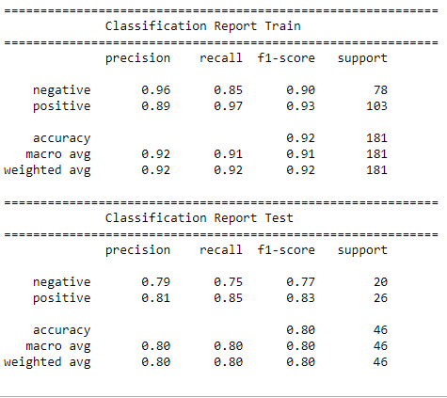
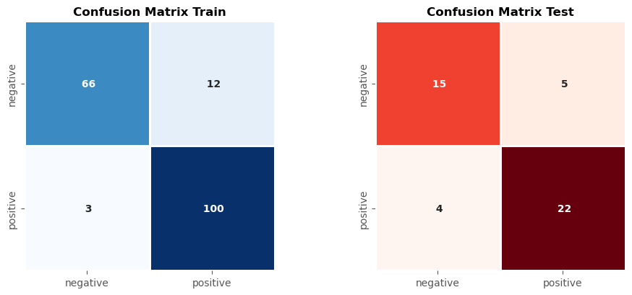
Model Building and Evaluation
From the confusion matrix, we can see that metrics of misclassification is very low
Model shows better accuracy in predicting the target variable
we can see there is a balance between the precision and recall.
The Model can classify both labels, which shows the model is in optimal value of bias-variance trade-off
The accuracy is 80% on test data sample and 92% on train dataset sample

Slide 13
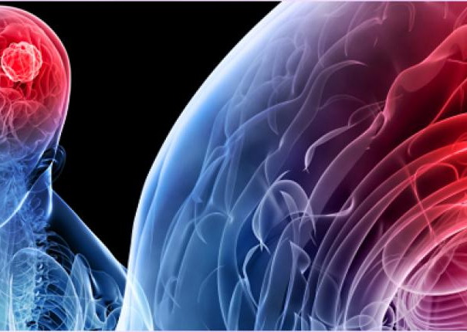
Results and Future Directions
The Brain Tumor prediction Model has yielded promising results
Collect more diverse and extensive datasets to improve the model's generalization and robustness.
Explore the integration of multiple imaging modalities (e.g., MRI, PET, CT scans) to enhance the accuracy of tumor detection.
Extend the model's capabilities to predict genetic characteristics directly from imaging data, reducing the need for surgery.
Continue to ensure that the project adheres to ethical guidelines, data privacy regulations, and relevant medical standards.
This Photo by Unknown Author is licensed under CC BY-NC-ND

Slide 14
Tan, M., & Le, Q. V. (2019). EfficientNet: Rethinking model scaling for convolutional neural networks. International Conference on Machine Learning, 6105–6114. http://proceedings.mlr.press/v97/tan19a/tan19a.pdf
Sajjad, M., Khan, S., Muhammad, K., Wu, W., & Ullah, A. (2019). Multi-grade brain tumor classification using deep CNN with extensive data augmentation. Journal of Computational Science, 30, 174–182. https://doi.org/10.1016/j.jocs.2018.12.003
Pereira, S., Pinto, A., Alves, V., & Silva, C. A. (2016). Brain tumor segmentation using convolutional neural networks in MRI images. IEEE Transactions on Medical Imaging, 35(5), 1240–1251. https://doi.org/10.1109/tmi.2016.2538465
REFERENCES

Slide 15

THANK YOU

